Slide 1
An Investigation of the Rotation of Open Clusters in Gaia DR3
A discussion (?)
Arvind Hughes, Coryn Bailer-Jones Galaxy Coffee 2023

Slide 2
Rotation & Clusters
Why do we care?
To care about rotation we have to know whether it exists first or not..
Significant work on rotation has been done for globular clusters (Kacharov et al. 2014; Koch et al. 2018; Bianchini et al.2018; Sollima et al. 2019…)
Less work on open clusters ( Loktin et al. 2020; Hao et al. 2022; Guilherme-Garcia et al. 2023)

Slide 3
Data
Gaia DR3
Ra, Dec
Proper motions, Errors, Covariance
Parallax, Distance
List of known Open Clusters and their members ( Cantat-Gaudin priv. com)

Slide 4
Method
Recap
Model – Simple 3D solid body defined by 3 parameters (Sollima et al. 2019)
Theta [Deg] (0-360)
Inclination [Deg] (0-90)
Rotational velocity [km/s]
Maximise likelihood - Sampler = MCMC

Slide 5
Simulations
Simulated Cluster

Slide 6
Simulations
Hughes (2023) in prep

Slide 7
Simulations
Hughes (2023) in prep

Slide 8
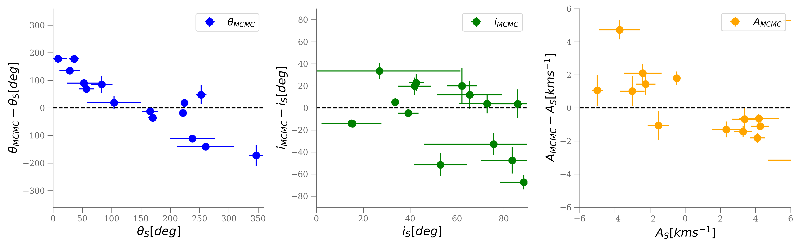
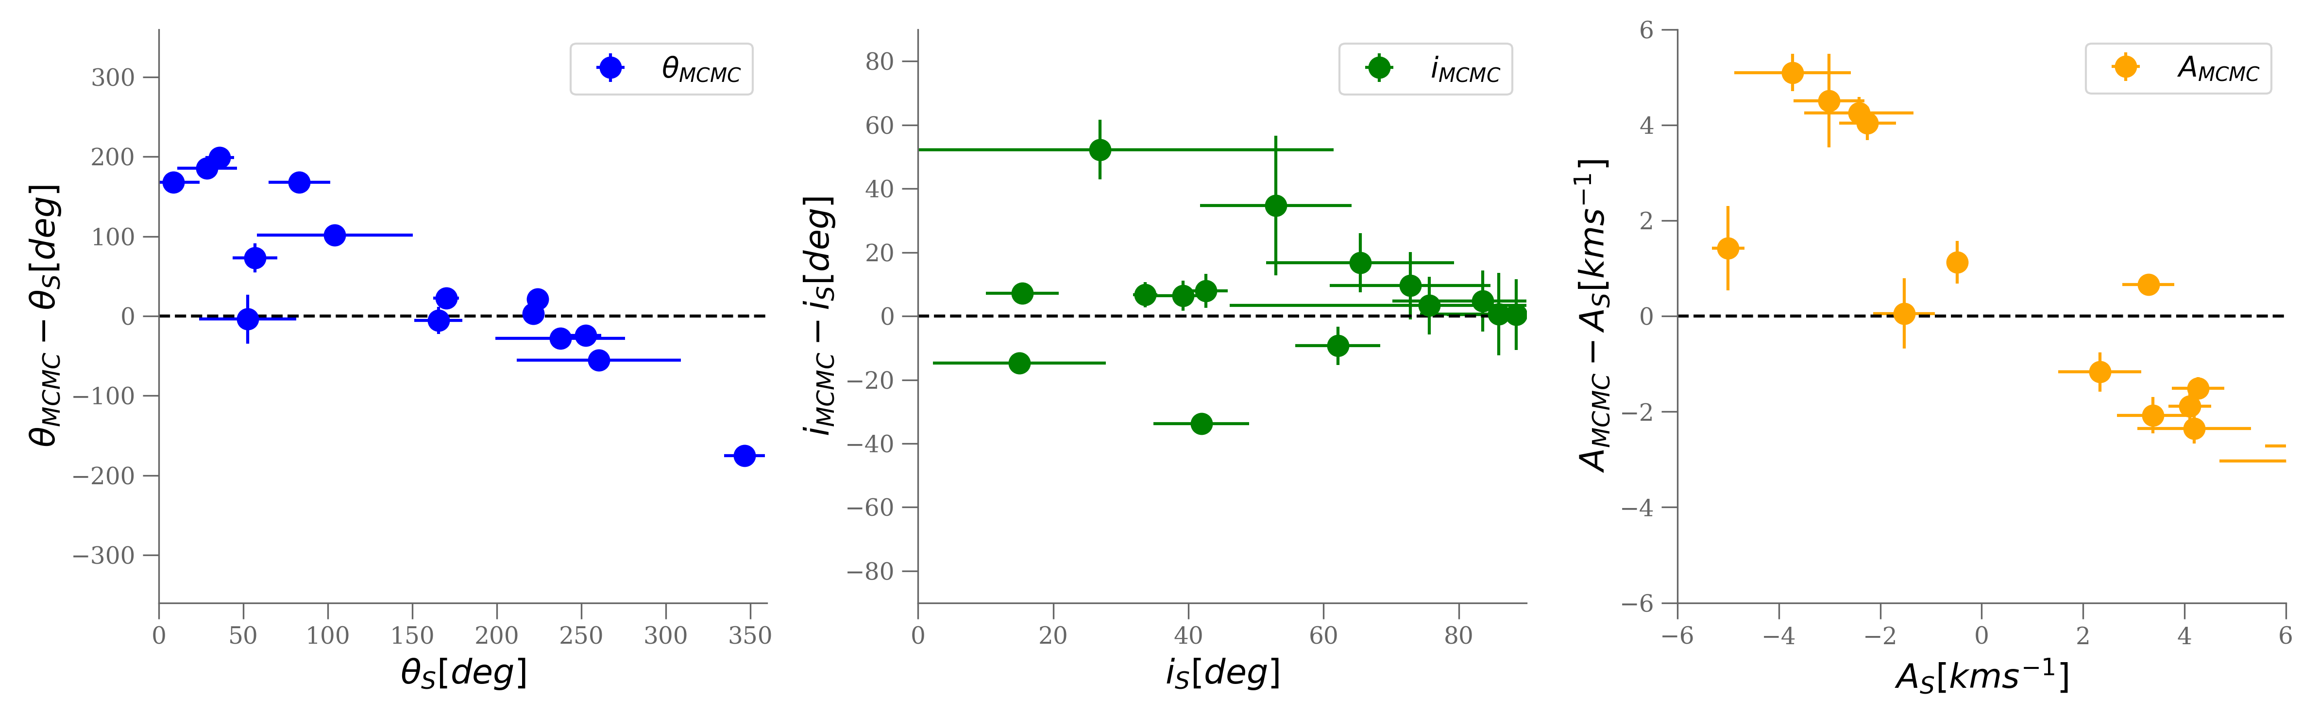
Globular Clusters
Gaia only compared to Gaia + additional RV’s
Hughes (2023) in prep

Slide 9
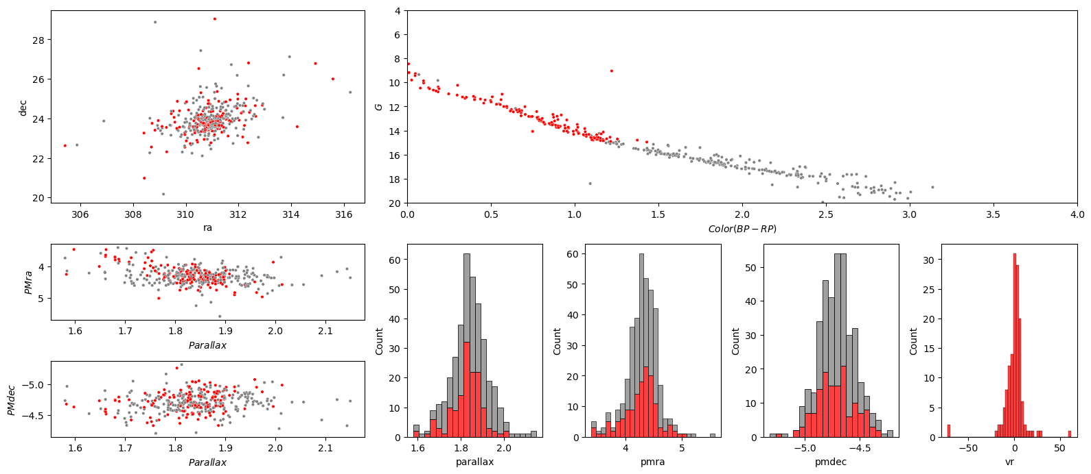
Open Clusters
Alessi 12

Slide 10
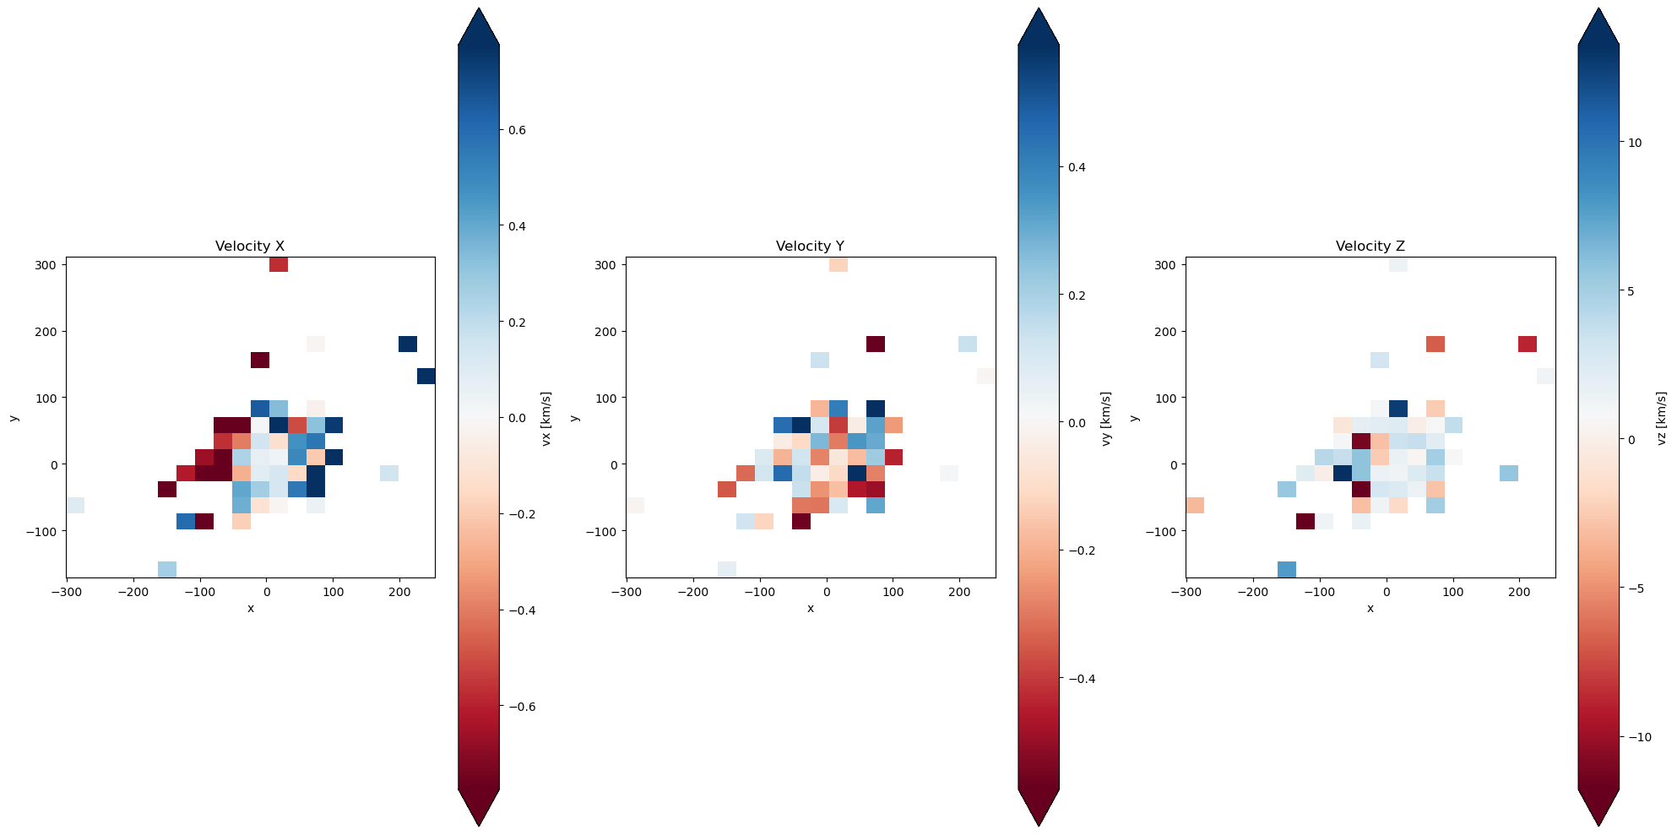
Open Clusters
Alessi 12
$θ=106.37 ±11.3 , i=89.6 ±0.85 , A=0.04±$ 0.01

Slide 11
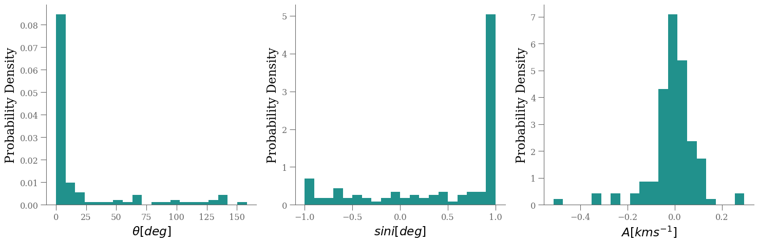
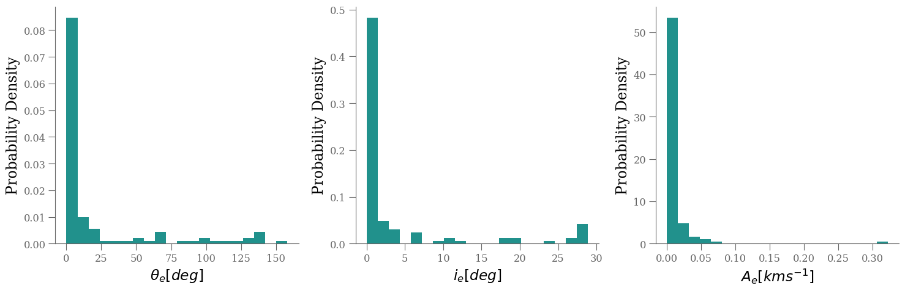
Open Clusters
Hughes (2023) in prep

Slide 12
What next?
Investigate the clustering of inclination
Construct a more complex model for open clusters instead of considering as a simple solid body
Ground based spectroscopy to get more RVs

